Slide 1

Prime numbers and cryptosystems
Presented by Fawaz

Slide 2
Introduction
Prime numbers are extremely unique numbers.
They are the building blocks of all integers, there is no predictable pattern to their distribution.
Due to their properties their used in cryptosystems
Primes are used in several cryptosystem protocols, Diffie-Hellman key exchange, ElGamal encryption, etc.
But we will be focusing on RSA today
Prime numbers are unique and difficult to find at larger integers.
Unique and difficult to find/understand are properties which are ideal in cryptosystem protocols

Slide 3

RSA
What it is
RSA (Rivest-Shamir-Adleman) is one of the most widely used public-key cryptographic systems.
It enables secure data transmission by relying on the properties of primes and the difficulty in factoring a large prime
.
What its used for
RSA encryption is used to provide authenticity for internet messaging.
It has applications in digital signatures, secure communication protocols (like SSH and HTTPS), encrypting email messages, virtual private networks, and software protection.

Slide 4

How RSA works
N=pq where p and q are large primes
T=(p-1)(q-1) *T is the Euler totient
Choose 2 integers e and d where e*d mod T = 1, e must be an odd number
Public key P=(e,N) and secret key S=(d,N)
Encrypted message C = Me mod N
Message M= C^{d} mod N
For example;
Let A=1 and B=2
Lets take a letter B to encrypt and decrypt. M=2 (message)
Let our primes be p=2 and q = 5. for simplicity
N=10,
T= 4 , e could be 3 and d = 7 as 3 * 7 mod 4 = 1
So keys,
P = (3,10) and S = (7,10)
To encrypt message M=2
C = Me mod N = 2 ³ mod 10 = 8 mod 10
C = 8, which is the letter H.
So if an authorised person wants to decrypt the message
M= C^{d} mod N , 8 ⁷ mod 10 = 2097152 mod 10, 2 mod 10
M= 2,which is the letter B
This is how it works
It may not seem too complex. But the hard part is yet to come

Slide 5
can you tell which is a prime?
7
9
327
5303
What about this
2519590847565789349402718324004839857142928212620403202777713783604366202070
7595556264018525880784406918290641249515082189298559149176184502808489120072
8449926873928072877767359714183472702618963750149718246911650776133798590957
0009733045974880842840179742910064245869181719511874612151517265463228221686
9987549182422433637259085141865462043576798423387184774447920739934236584823
8242811981638150106748104516603773060562016196762561338441436038339044149526
3443219011465754445417842402092461651572335077870774981712577246796292638635
637328991215483143816789988504044536402352738195137863656439121201039712282212
0720357
Well it is not a prime, but it is the product of two primes. Meaning it’s a suitable N for RSA encryption.
It’s a 2048 bit number which is the standard for RSA.
This number is so large that till this day no one knows the factors, and there's a $200,000 prize for who finds it first.
RSA is secure by being infeasibly computable within a realistic time frame
But how can you tell if such a large number is a prime.

Slide 6
Primality testing
What is it
Primality testing is the process of determining whether a given number is a prime. At advanced levels this is based on probability. Since cycling through every odd number for its factors will take years at 200 bits not to talk of 2000 bits. Here are some tests
Fermat’s test
If n is a prime number and a is any integer such that 1<a<n, then
𝑎^{𝑛−1} ≡ 1 ( mod n).
This means that when 𝑎^{𝑛−1} is divided by n, the remainder is 1.
Test it yourself with primes you know .
Time complexity is Õ(k log² n) where k is the number of times a is chosen
Although there are various numbers which can pass this test while not being prime
Miller-Rabin test
This is built on the Fermat's test with the aim of being more secure while being just as fast.
changing a from a random number to a known prime. And d an odd integer and adding another condition.
𝑎^{d} ≡ 1 ( mod n).
𝑎^{2^r * d} ≡ -1 ( mod n).

Slide 7
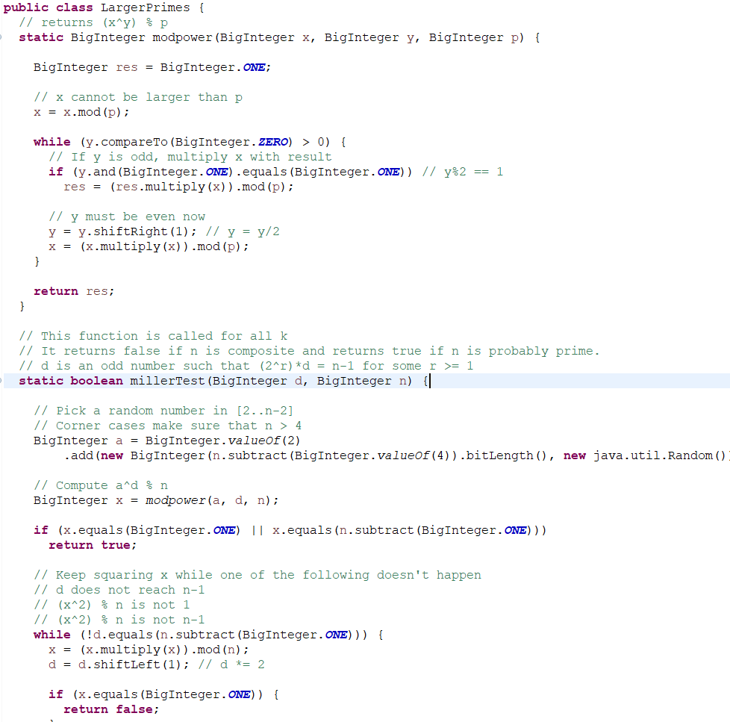
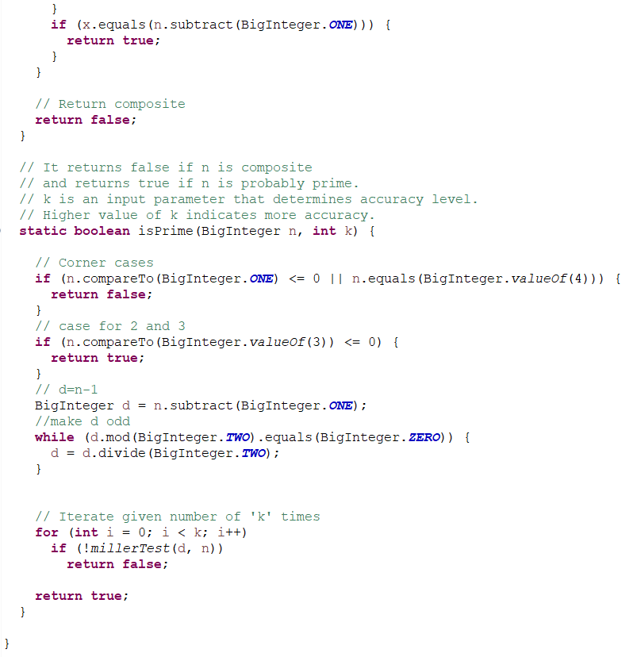
Code
You'd notice something called big integer.
It’s a unique data type with its own set of math functions
Since java cant store more than 64 bits or 19 digits. It wont ever be able to test and compute primes of up to 1024 bits or 300 digits
This code applies the conditions for the miller-rabin test for up to k cycles.
Time complexity is Õ(k log² n)

Slide 8
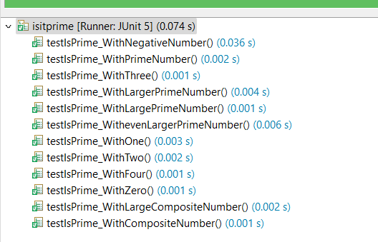
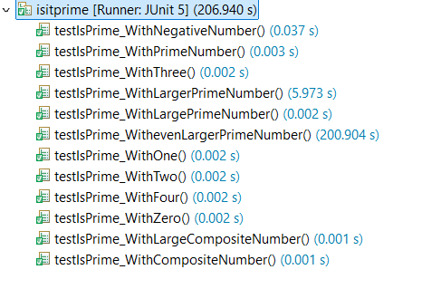
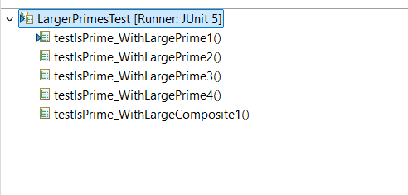
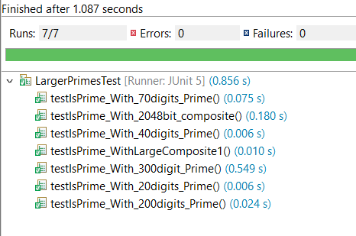
Testing
To the point where it couldn’t process the primes within hours
But with the miller-rabin test, it tested primes with 20* the digits in way shorter time. Here the number of cycles decide compute time.
As 300 digits needed more cycles k compared to 200 digits
This was my first test. Using simple primality test such as checking n whether it is divisible by any odd number between 2 and sqrt(n)
As I increased the prime being tested towards the long limit of 64 digits. The simple test started taking longer as long as 3 minutes

Slide 9

01
ALGORITHM FOR GENERATING LARGE PRIME NUMBERS
02
Implementing RSA on its own with tests
Future steps
to take
03
Create a system which implements RSA and the viewing differences between users and permissions
04

Slide 10
Thank
you
Questions?

